Slide 1
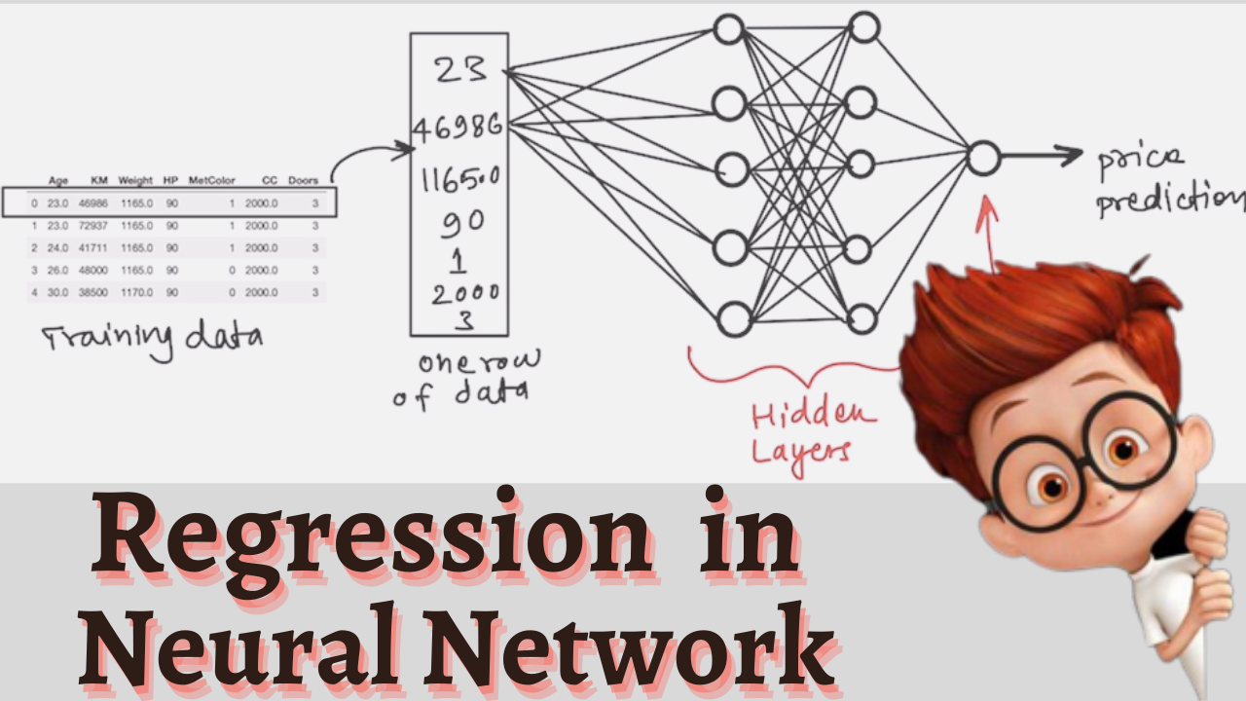

Slide 2
Car Price Prediction
S NO | Age (Years) | Kms_driven | Fuel Type | Price (Lakhs)
1 | 8 | 27000 | Petrol | 3.35
2 | 9 | 43000 | Diesel | 4.75
3 | 5 | 6900 | Petrol | 7.25
4 | 11 | 5200 | Petrol | 2.85
5 | 8 | 42450 | Diesel | 4.6
6 | 4 | 2071 | Diesel | 9.25
7 | 7 | 18796 | Petrol | 6.75
8 | 7 | 33429 | Diesel | 6.5
9 | 6 | 20273 | Diesel | 8.75
10 | 7 | 42367 | Diesel | 7.45

Slide 3

Model
R
R
Age
R
R
Price
Kms
R
R
Fuel
R
R
R
R

Slide 4
Model
R
R
Age
R
R
8
Price
27000
Kms
R
R
5
Petrol
Fuel
R
R
R
R

Slide 5
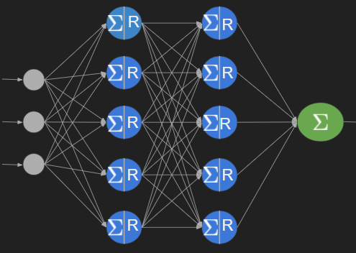
Training
Loss = |Y-Y^|
Targets
Features (X)
Y
Entry-1 8 27000 Petrol 3.5
Entry-2 9 43000 Diesel 4.75
. .
. .
Entry-n 7 33400 Diesel 6.5
Y^
3
6.5
.
.
8
Loss
Gradient Descent
Updates
Weights & Biases

Slide 6
Prediction
R
R
Age
R
R
8
Price
27000
Kms
R
R
5
Petrol
Fuel
R
R
R
R

